Slide 1
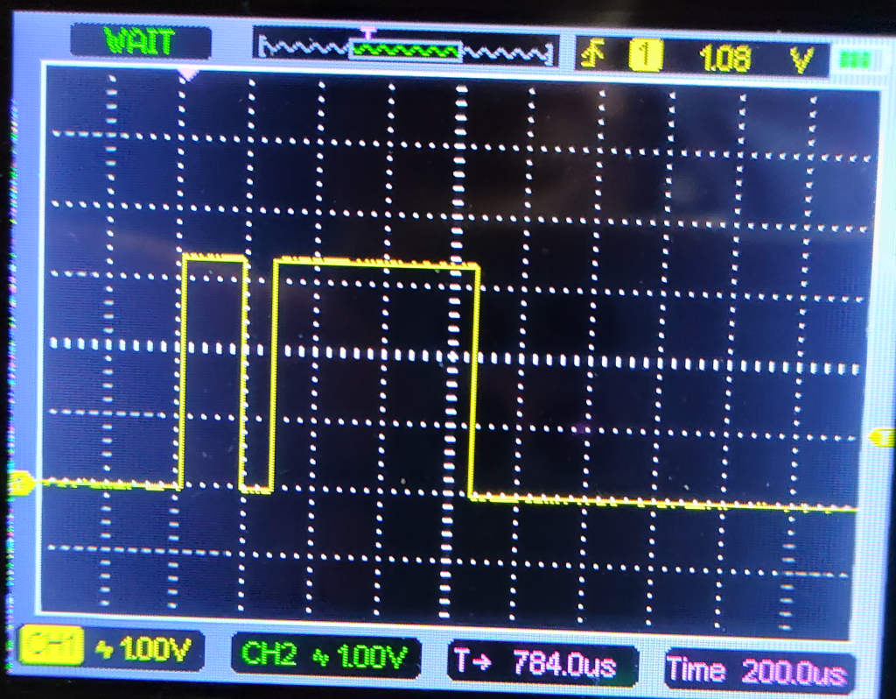
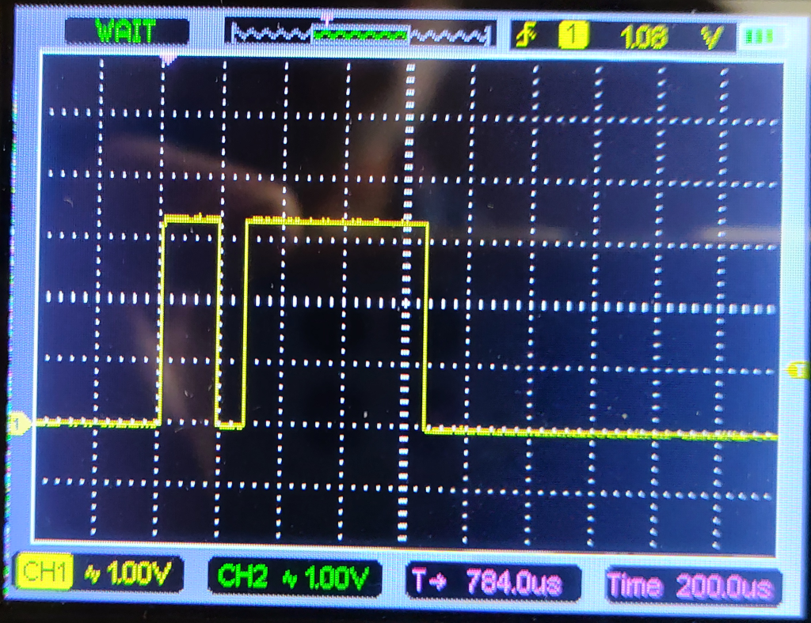
RF cold start time
RAT + __ondomain + RFC_PWR_PWMCLKEN_MDMRAM | RFC_PWR_PWMCLKEN_RFERAM)
XOSC startup = ~200us
This is for low-power auto-send (identical)
The rest, including patches

Slide 2
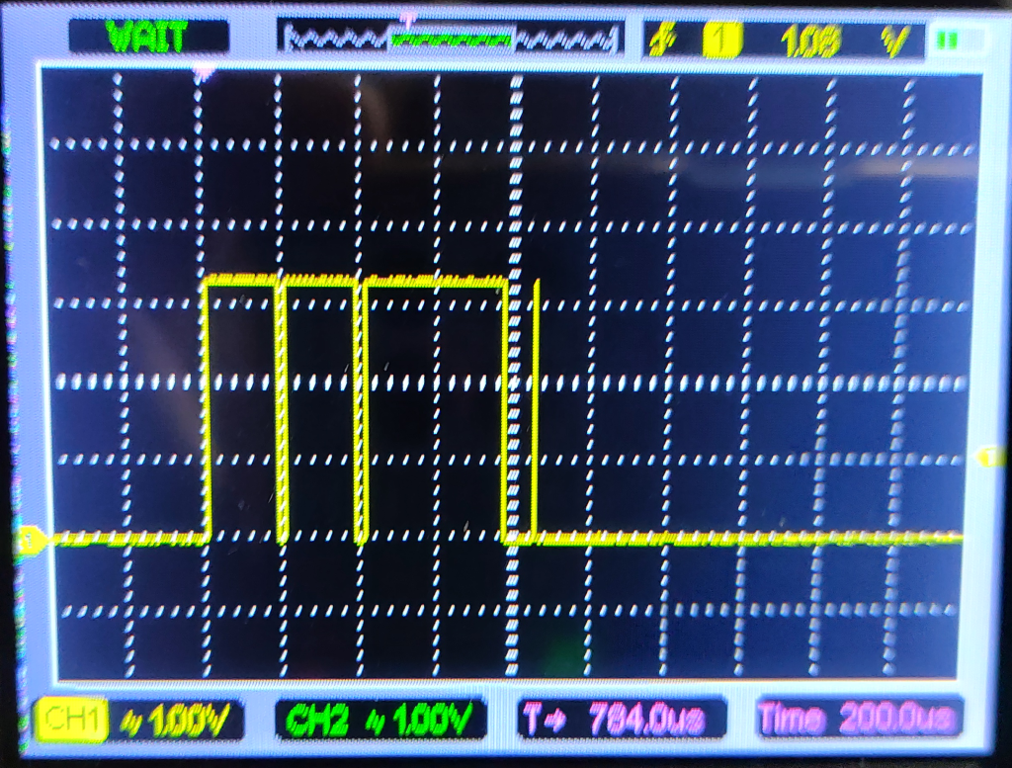
RF cold start time
XOSC startup
__ondomain, clock enable
patching incl cmnds
init, trim, ldo
setup prop, rat
set freq
int enable

Slide 3
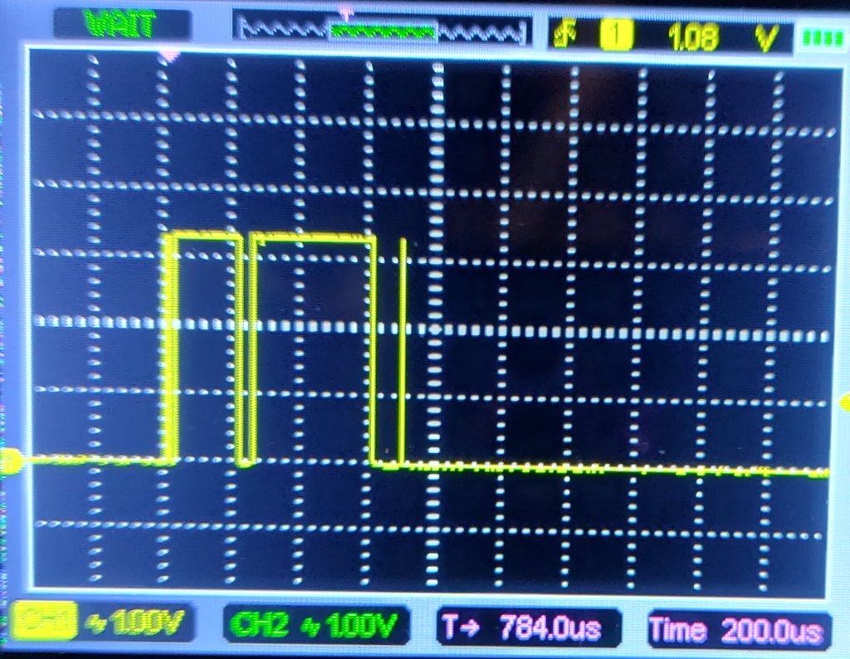
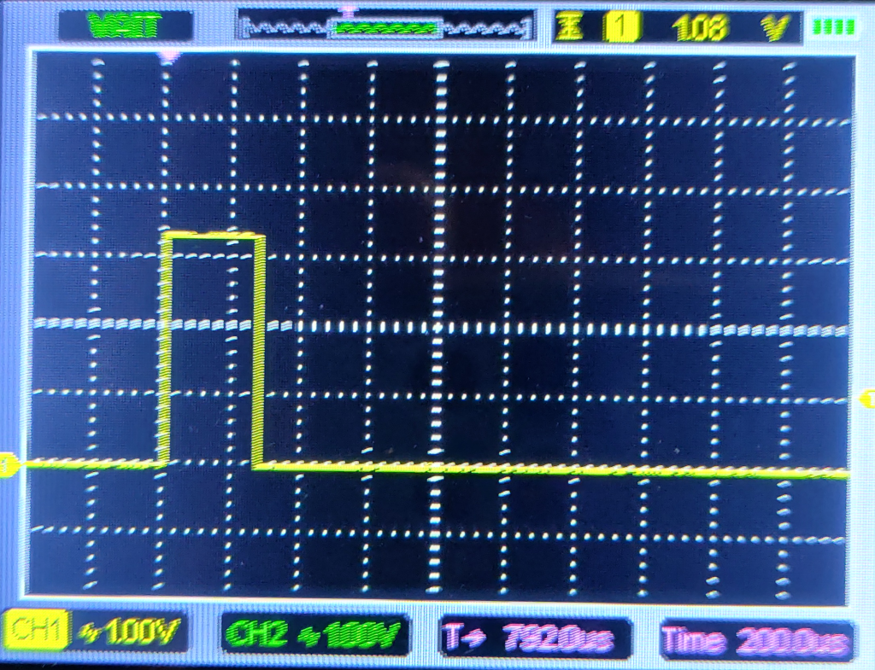
This is after postponing XOSC check
This is the final word
Does not depend on PD mode

Slide 4
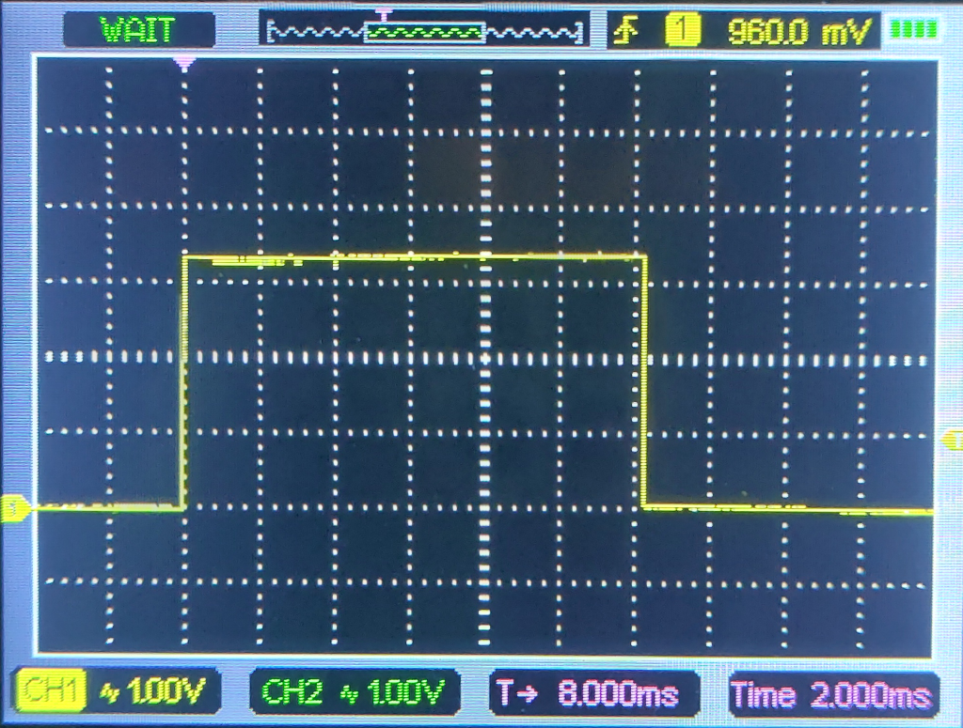
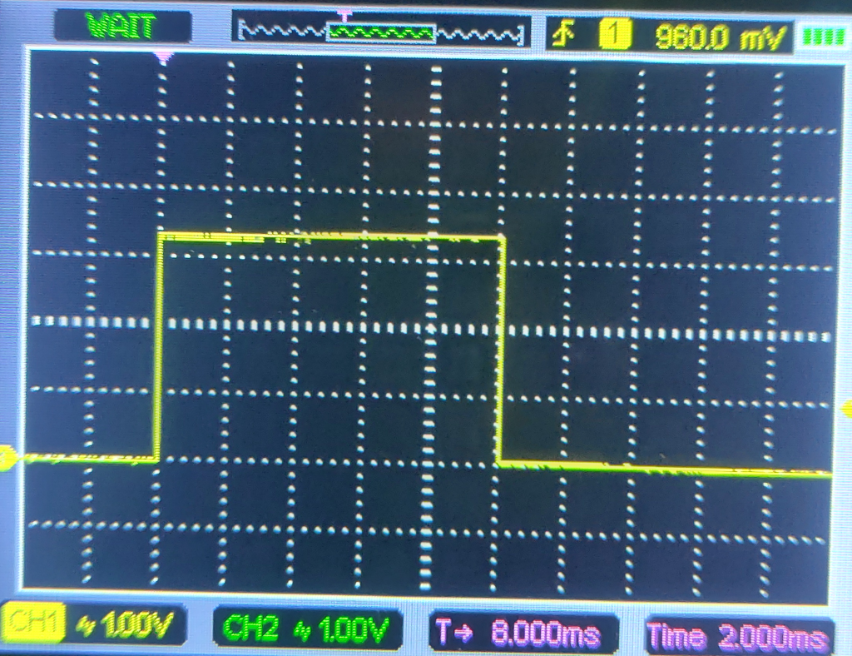
48-byte (RFTEST) packet sent @ 50kbps = 12 ms??
the same with LBT disabled (2 ms default)
500 bits = 65.5 bytes → 13 bytes extra: 48 includes CRC + NETID, the rate comes out 38,400!!!

